Slide 1

Airline Delays:
Team Members: Wei Zhu, Desiree Diaz, Adam Katz, Irene Okada

Slide 2
Problem statement: Airline delays are a problem. Our goal was to create the beginnings of an informative user- friendly platform that is a resource for customers to view the delay status of airlines and airports. Included are search features that meet project requirements. Data source was Kaggle and due to the volume of data we focused on one day; Jan 1 2018.

Slide 3

Project Elements we included
Combination of web scrape/leaflet/plotly/js
Landing page; flask-api, Scrape, html, css, database (mongo)
Leaflet heatmaps of airport delays
Dashboard and heatmaps using plotly , js, leaflet
New JS feature: search table; datatables.net
plug-in for js

Slide 4
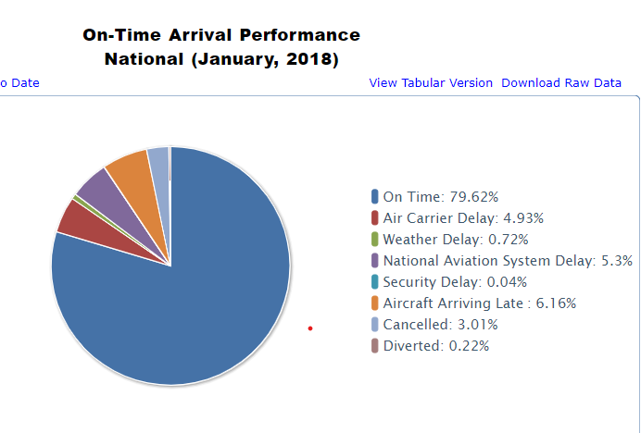
Overview- airline delays are a problem (Natl. Bureau of Transportation)
Natl. Avg delay rate: 21%

Slide 5
Break slide

Slide 6
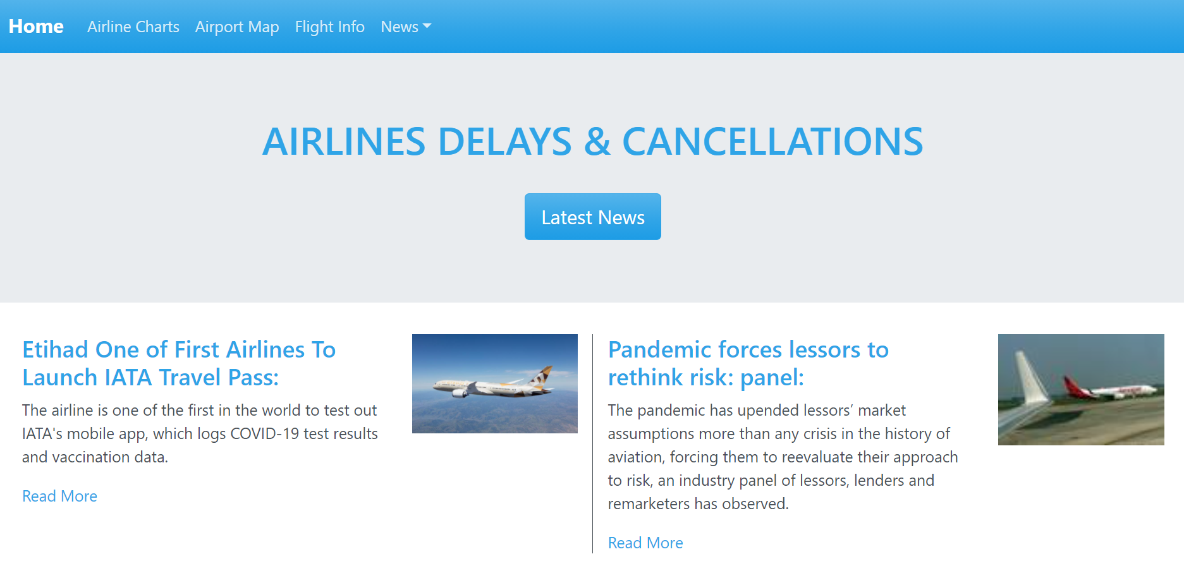
Element 1: Home page
(screenshot of website)
Welcome page
Customer navigation
Provide information to user about delayed flights and airport information
Created using mongo DB with flask to scrape items on website
Clicking on button activates scrape and updates news
Active links to further information
Dropdown links for resource

Slide 7
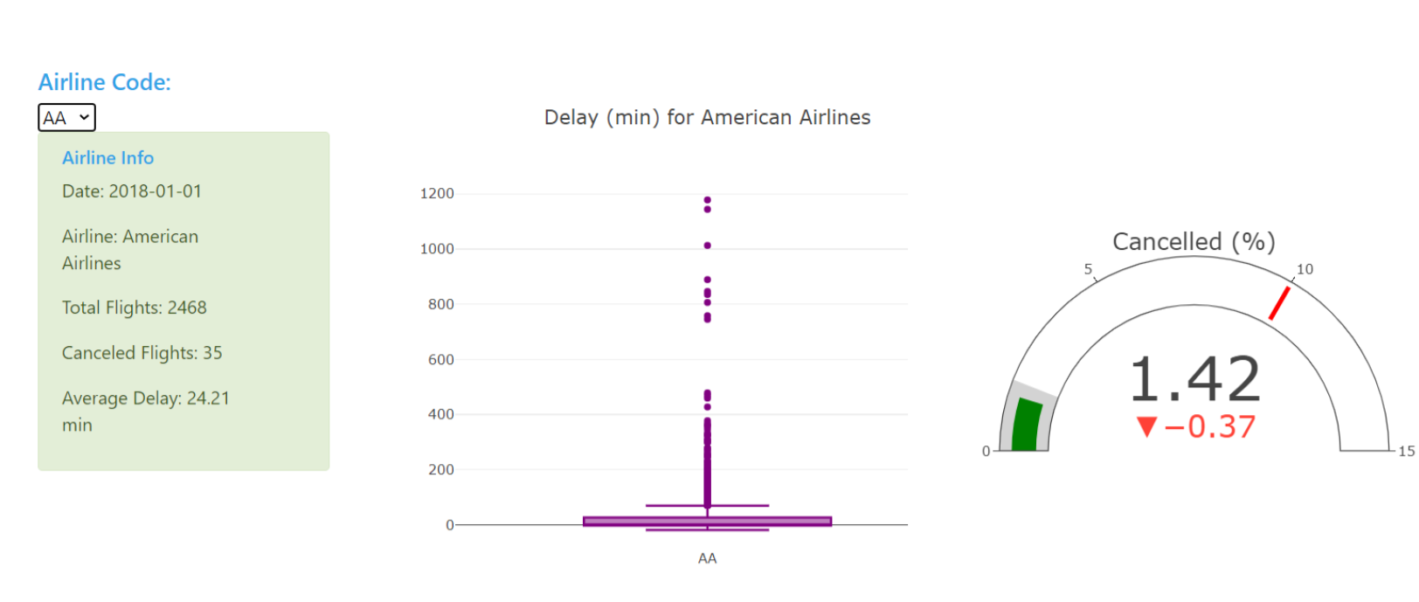
Dashboard
Dashboard 1
Reflecting airport and airline delays
Graphs updated by selected input
Featuring plotly/js

Slide 8
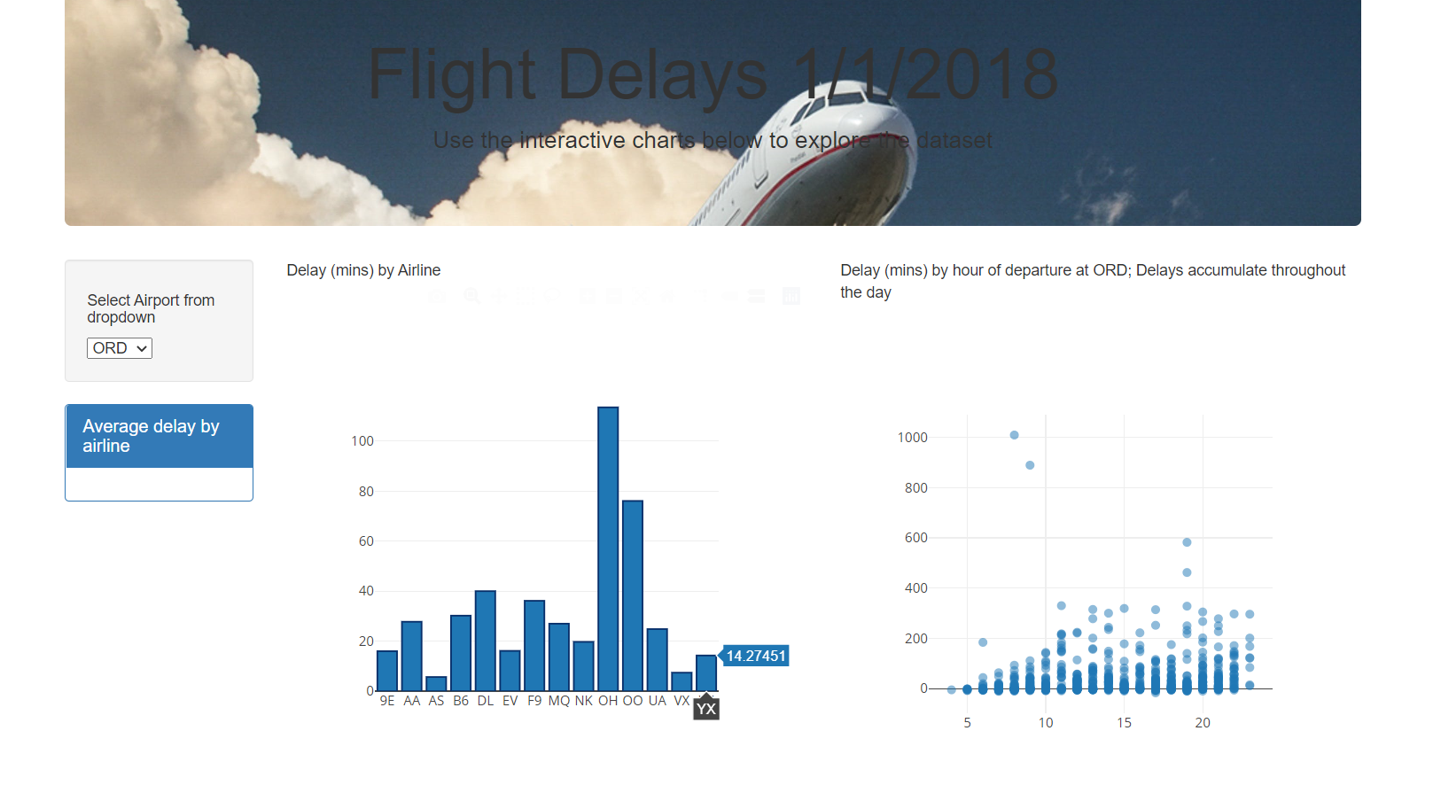
Dashboard
Dashboard 2
Reflecting airport and airline delays
Graphs updated by selected input
Featuring plotly/js

Slide 9
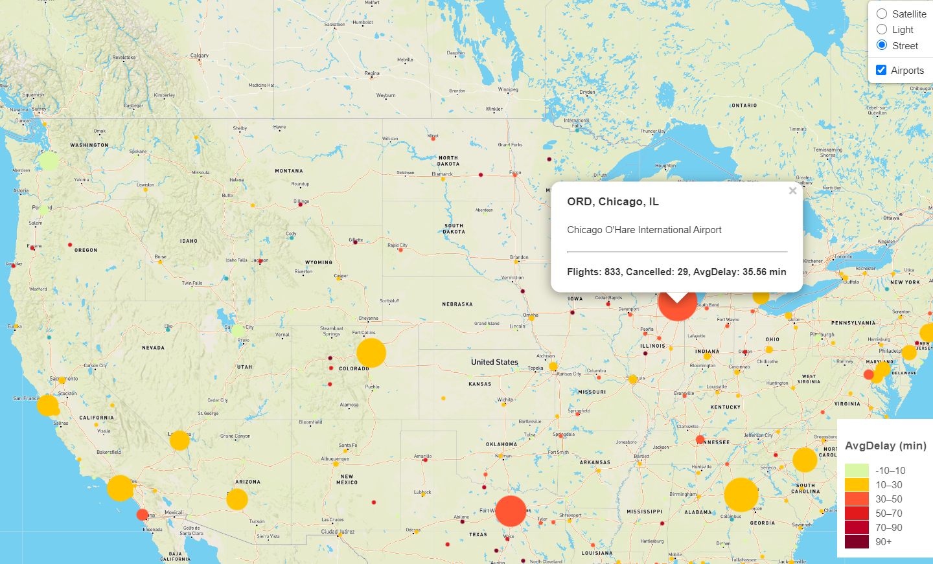
Airport map
Heatmap using js mapbox and leaflet
Overlay of weather and darkview maps
Includes legend
Legend control and hovertext with flight info

Slide 10
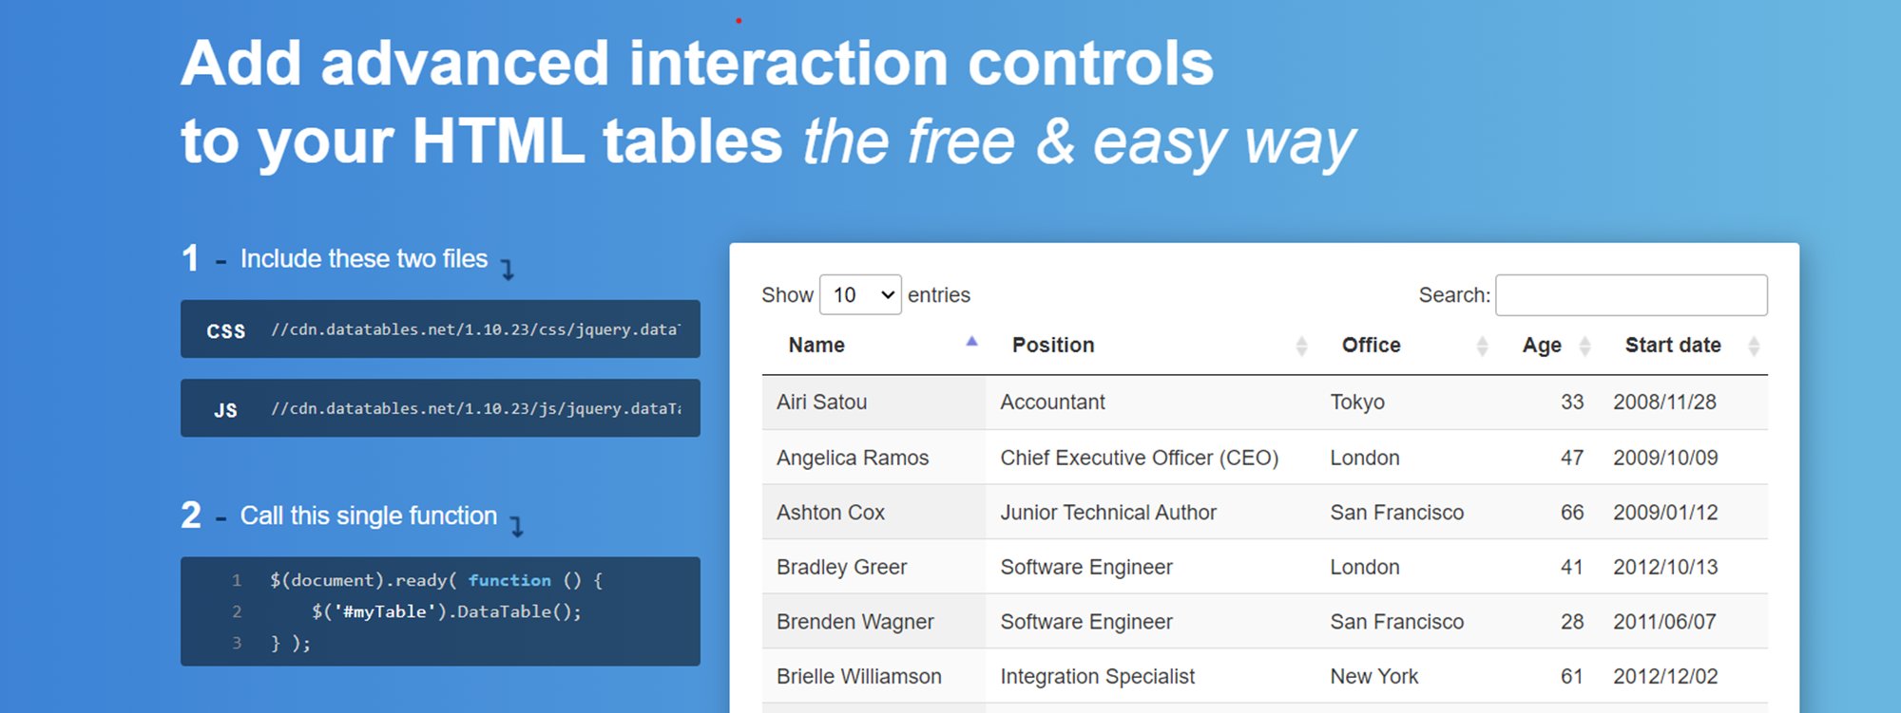
Added js library feature
Js plug in that allows data compilation
Pagination and search features.

